Slide 1
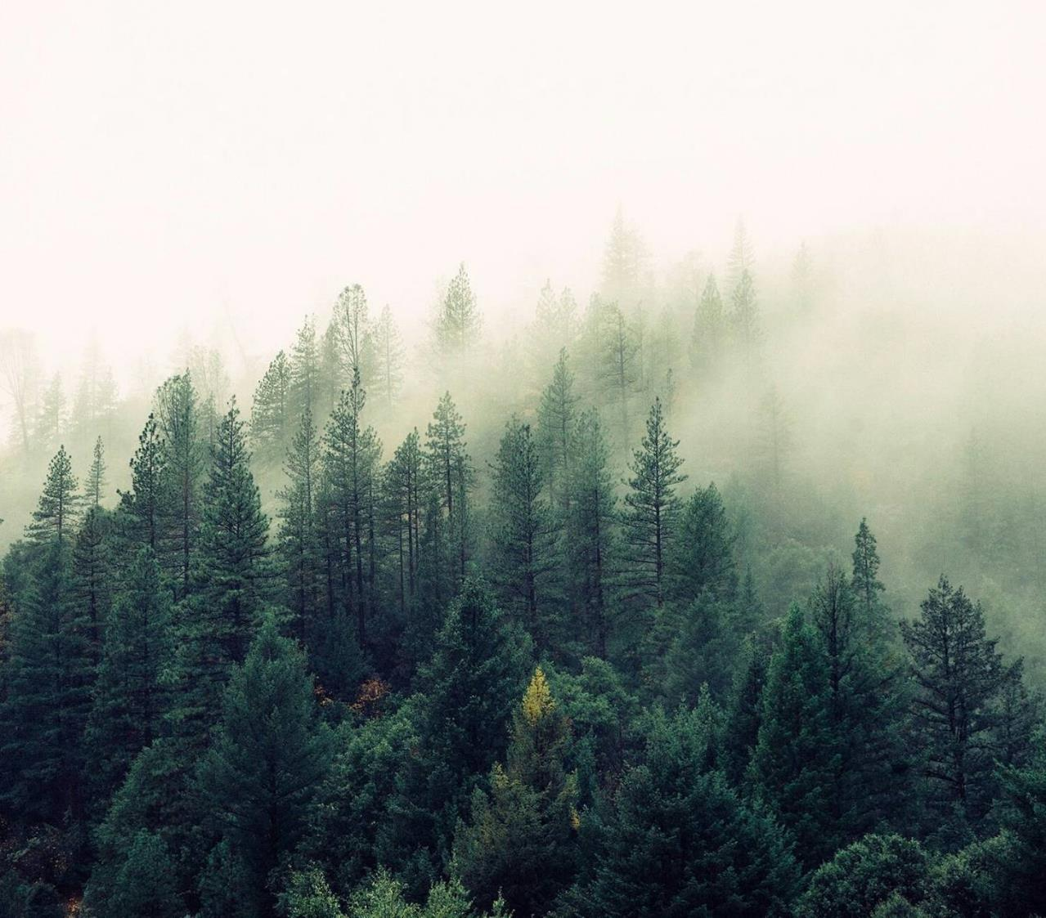
AI-FireGuard
Thermal-RGB Fusion for UAV-Based Wildfire Monitoring

Slide 2
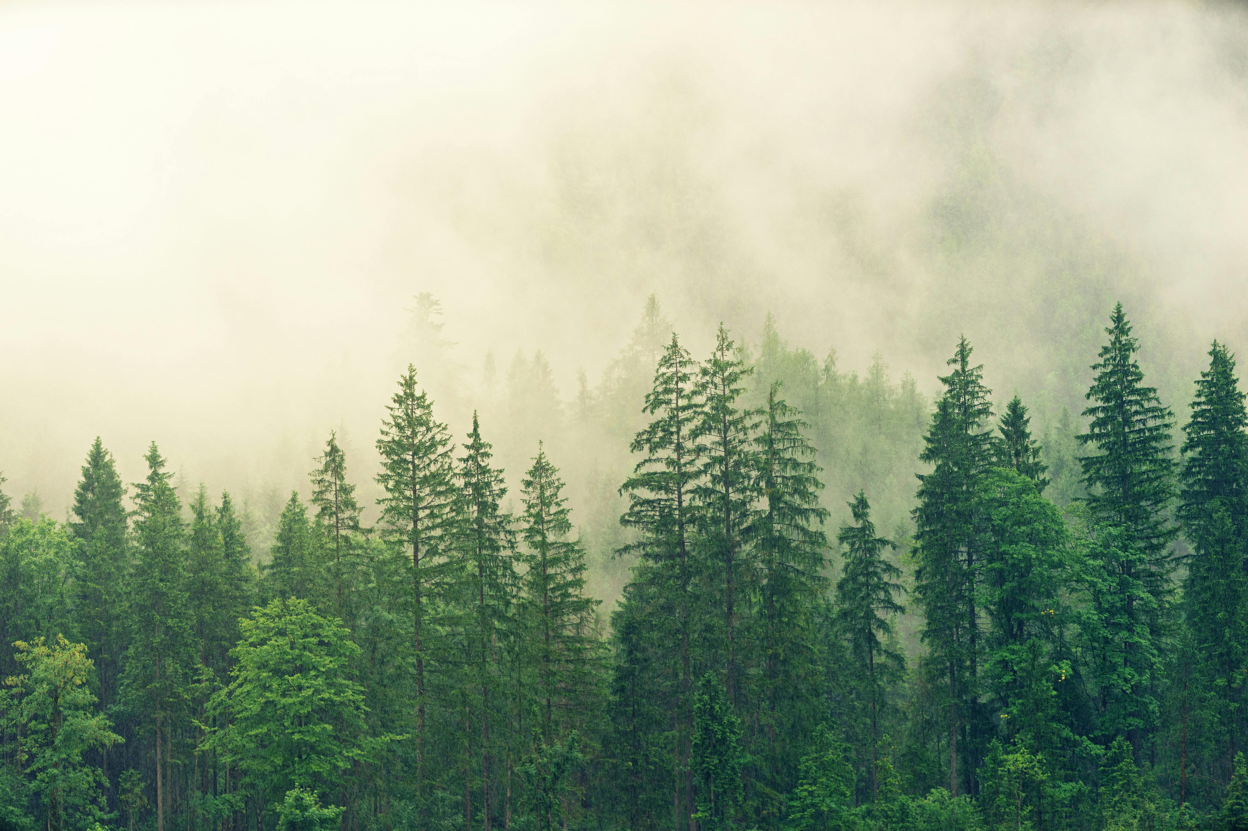
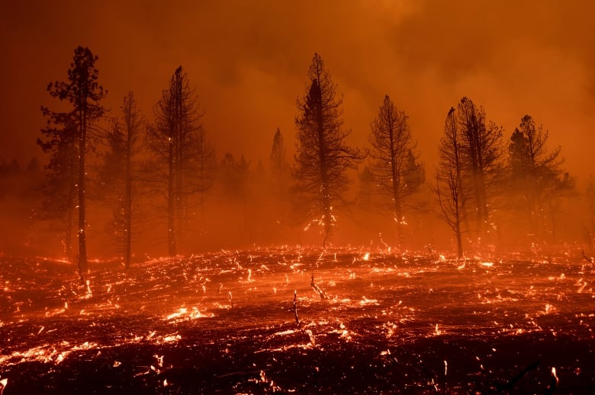
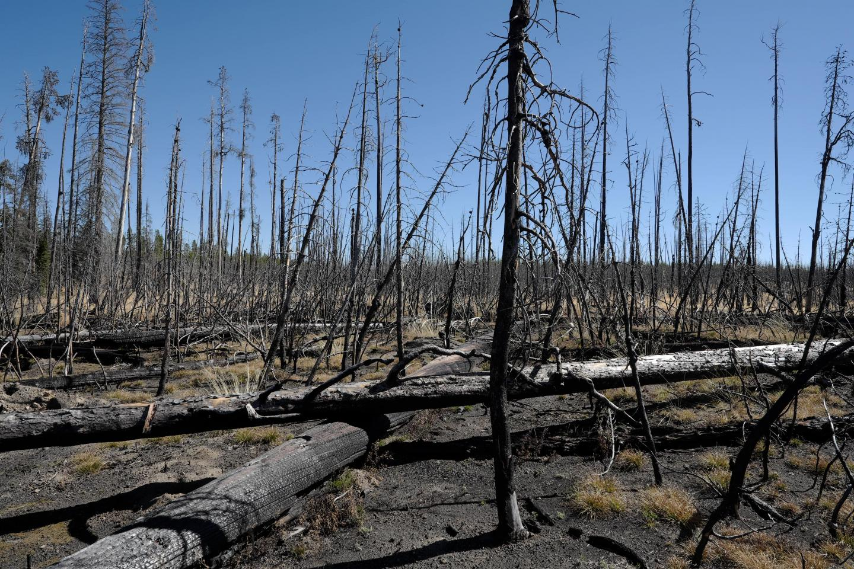
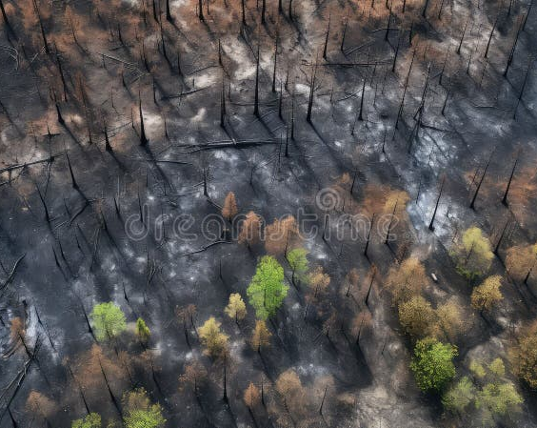
Agenda
Project Significance & Objective
Reference Studies
Data Set OverView
Project workflow (Methodology)
Results & Future Vision
Argument

Slide 3
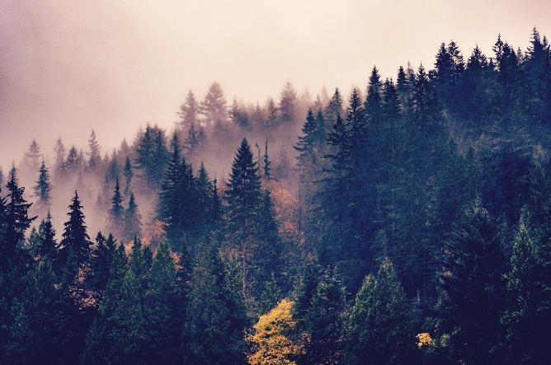
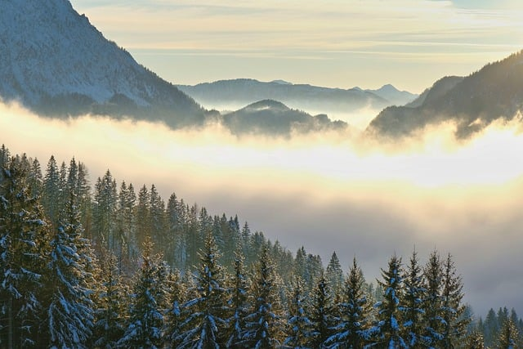
Introduction
This project develops a deep learning model for wildfire detection using the RGB-T (Visible + Thermal) Wildfire Dataset.
It utilizes Google Colab with GPU acceleration for training and evaluation.
The workflow covers dataset preparation, preprocessing, and model training with metrics like accuracy, Dice, and IoU.
The goal is to enhance early wildfire detection through RGB-T data fusion and AI-based image analysis.

Slide 4
Project Idea(Significance & Objective)
The Significance:
Wildfires are increasing and require fast, accurate detection.
Traditional methods often fail in low light, smoke, or long distances.
RGB-T imaging with AI improves detection reliability and speed.
Helps support quicker response and reduces wildfire damage.
The Objective:
Build a deep learning model using RGB + Thermal images.
Improve detection accuracy in difficult conditions.
Evaluate performance with Accuracy, IoU, and Dice metrics.
Enable real-time wildfire monitoring for practical deployment.

Slide 5
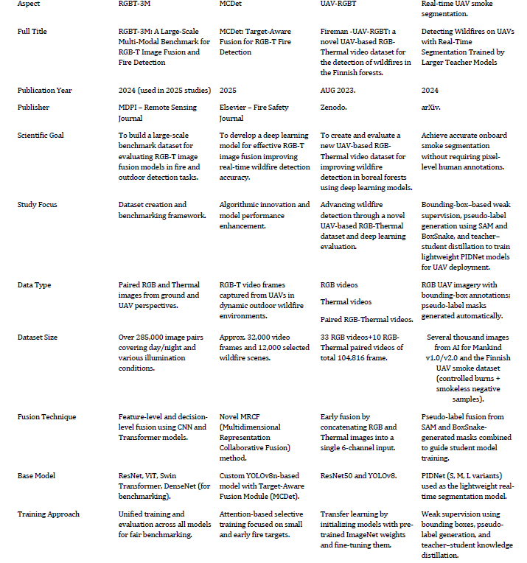
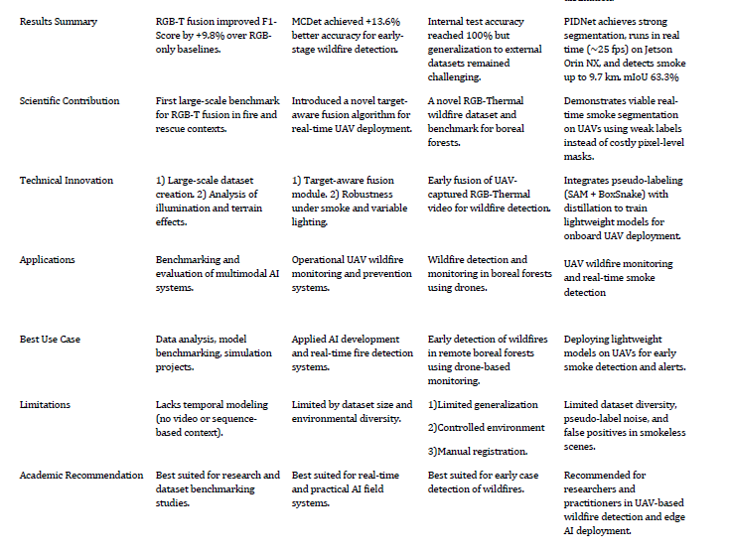
Reference Studies Comparison

Slide 6
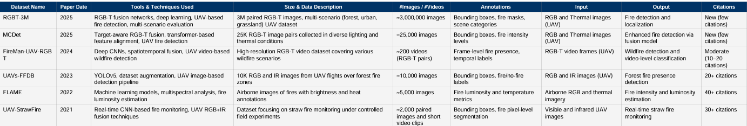
Dataset Comparison – UAV-based Fire Detection

Slide 7
Data Set OverView
Size & Distribution: This dataset, hosted by the University of Science and Technology of China (USTC), includes approximately 1,367 RGB–Thermal paired images. It is referenced in wildfire detection research as a compact but valuable benchmark dataset for multimodal fire analysis.
Modalities & Annotation: The dataset provides paired RGB and thermal images, captured under varied illumination and fire intensity conditions. Annotations support semantic segmentation tasks, labeling fire and non-fire regions, enabling multimodal training for deep learning models.
Dataset Specifics: - Format: Image pairs (RGB + Thermal) - Approximately total samples: 1,367 - Target task: Fire detection and segmentation - Annotation type: Pixel-level segmentation masks - Data balance: Fire vs non-fire, collected in both day and night settings
Use-Cases & Research Impact: It supports tasks such as wildfire detection, multimodal fusion learning, and real-time UAV-based thermal imaging analysis. Commonly used in comparative studies alongside datasets like FLAME-1 and FireMan-UAV-RGBT.
Remarks & Limitations: The dataset’s modest scale limits generalization but offers a valuable baseline for fusion-based fire detection. Access may require university credentials or approval.
Reference Link: https://rec.ustc.edu.cn/share/75aae550-8d26-11ee-98a1-ed4fd857523e

Slide 8
Project workflow (Methodology)
1. Data Preparation
Dataset Setup
Downloaded RGB-T wildfire dataset (ZIP files).
Mounted Google Drive and extracted the data.
Dataset structure: rgb/, nir/, mask/.
Library Installation
-Deep learning: PyTorch, TensorFlow, Keras
- Image processing: OpenCV, scikit-image, imageio
- Data & visualization: numpy, pandas, matplotlib, seaborn, plotly, tqdm
Augmentation: Albumentations
Data Loading & Verification
Loaded RGB, NIR, and mask images.
Skipped missing/incomplete samples.
Total valid samples: 1367
Image shapes: RGB (420,420,3), (512,640,3); NIR & masks (512,640)
Mask unique values: 0 (background), 255 (wildfire)
2. Data Preprocessing & Augmentation
Augmentation Strategy (Albumentations)
Training: horizontal/vertical flips, rotations, color jitter, Gaussian blur, resize, normalization
Validation: resize and normalization only
Custom Dataset Class
Combined RGB + NIR → 4-channel input
Applied augmentations dynamically
Converted to PyTorch tensors [B,4,H,W]for images and [B,1,H,W] for masks
Data Split & Loading
Train: 80%, Validation: 20%
Batch size: 4, shuffle enabled for trainingVisual Placeholder:
Sample RGB/NIR/mask images before and after augmentation
3. Model Design
Architecture: Custom 4-channel UNet
Encoder: 4 downsampling blocks
Bottleneck + decoder with skip connections
Output: single-channel mask
Loss Function: ComboLoss = 0.5 * Focal Loss + 0.5 * Dice Loss
Metrics: Dice coefficient, IoU, Accuracy, Precision, Recall, F1-score
4. Training & Optimization
- Optimizer: Adam (lr=5e-4)
- Epochs: 100, Early stopping patience: 15
- GPU acceleration (CUDA)
- Training loop:
1. Forward pass → predictions
2. Compute loss
3. Backpropagation & optimizer step
4. Compute metrics for train & validation
Early stopping monitored on best Dice coefficient
Best model saved as best_model.pth
5. Evaluation & Visualization
Loaded best saved model
Computed confusion matrix and all metrics
Plotted training & validation loss, Dice, IoU curves
Displayed sample inputs, ground truths, and predicted masks Visual Placeholder:
Learning curves (loss, Dice, IoU)
Prediction comparison (input, ground truth, prediction)

Slide 9
Results & Future Vision
Results
Future Vision
The model successfully detected wildfire regions using combined RGB–Thermal imagery.
Achieved strong evaluation performance with high (Accuracy=0.9965),( IoU=0.6684), and (Dice scores=07815).
Visual outputs show accurate fire localization in both daytime and nighttime conditions.
Fusion of RGB + Thermal data proved more reliable than using single-sensor inputs.
Deploy the model on UAVs, fixed surveillance cameras, or satellite systems for real-time monitoring.
Expand training using larger, more diverse datasets to improve generalization.
Integrate early-warning alerts for emergency response teams.
Build a full pipeline capable of real-time wildfire detection and tracking in challenging environmental conditions.

Slide 10
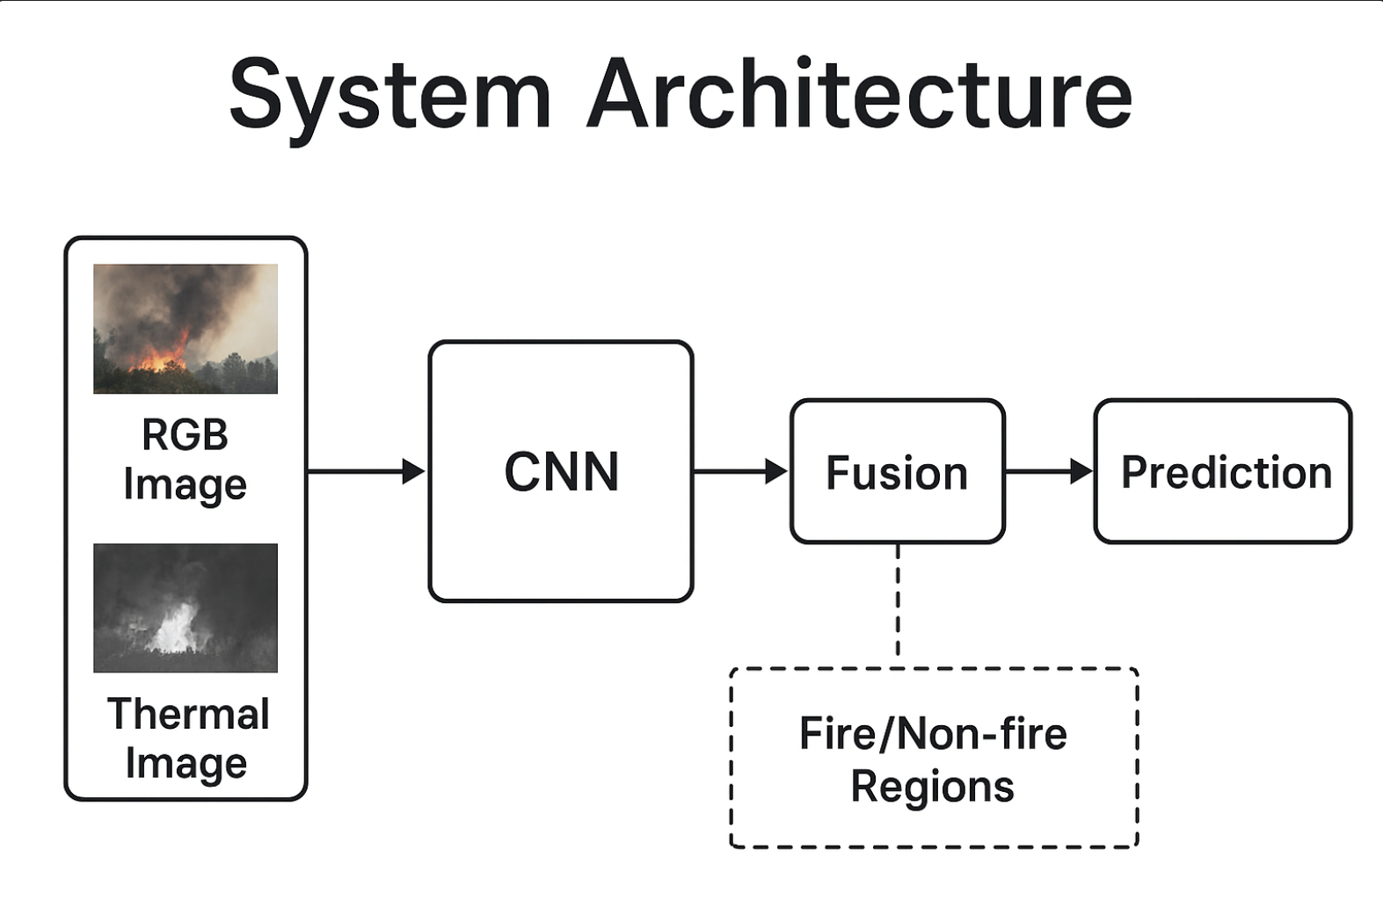
Argument
The challenge of accurate fire detection using UAV imagery arises from environmental complexity, low visibility, and significant variation in fire appearance across RGB and thermal modalities. Traditional single-modal systems struggle to maintain high detection performance in real-world conditions such as smoke, darkness, and occlusions. By leveraging a dual-modal RGB–Thermal dataset and a deep learning model trained on aligned multi-spectral inputs, the system provides more reliable detection and segmentation, improving safety, monitoring efficiency, and early-response capabilities.

Slide 11
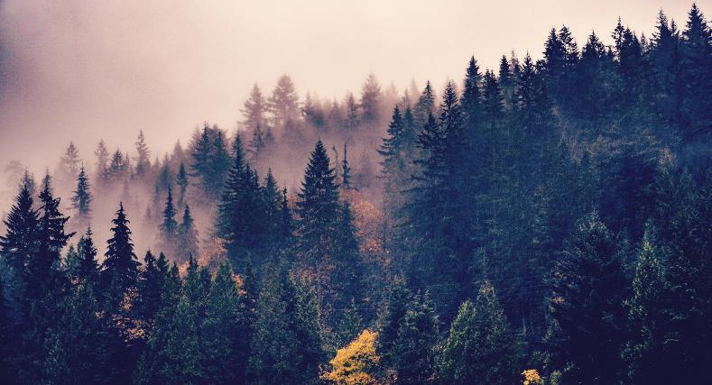
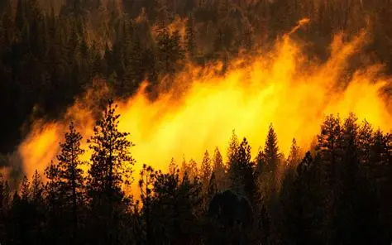
Summary
This project developed a UAV-based fire detection system using RGB-Thermal imagery and a deep-learning segmentation model. Through multi-modal fusion, data preprocessing, model training, and evaluation using accuracy, precision, recall, F1 score, and Dice/IoU metrics, the system achieved strong performance in identifying fire regions under challenging conditions. The results demonstrate the effectiveness of combining RGB and thermal data for robust wildfire detection and highlight the potential for future improvements such as real-time onboard deployment and advanced multi-modal architectures.

Slide 12
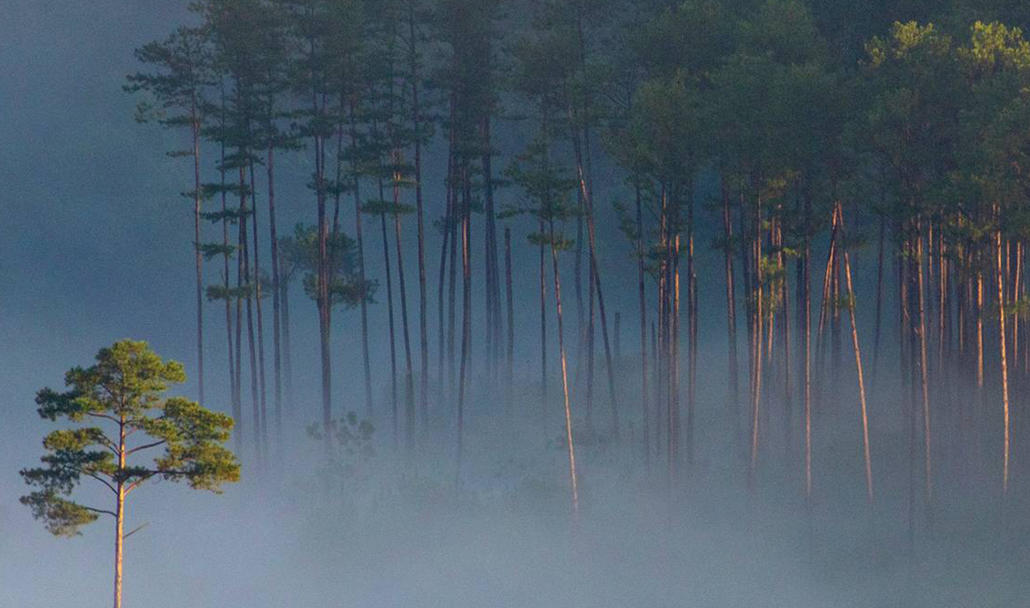
Thank you
BASHAR ALSALEH
KHAWLA ALSHAIKH
HANIN SHAHIN
JUDY DUKMAk
Supervised By:
Dr. RIAD SONBOL
Eng. AYA ALASWAD

